Slide 1
Santhi Priya D N
Nmid: F3DD3F8D22BCA8A92CC48D900875CE0E
Madras Institute of Technology campus, Anna University
Final Project Alzheimer’s Prediction using different Classifiers.

Slide 2
PROJECT TITLE
Alzheimer’s Prediction using Different Classifiers
3/21/2024 Annual Review

Slide 3

AGENDA
Data Collection and Exploration:
- Dataset overview, preprocessing, and exploratory analysis.
Feature Selection and Engineering:
- Identifying relevant features and engineering techniques.
Model Selection and Training:
- Selection of Random Forest classifier and training process.
Model Evaluation:
- Performance metrics and analysis of results.
Interpretation of Results:
- Examination of feature importance and model insights.
.
3/21/2024 Annual Review

Slide 4
PROBLEM STATEMENT
This project aims to develop a Random Forest classification model for predicting Alzheimer's disease based on relevant biomarkers and patient data.
Alzheimer's disease poses a significant public health challenge globally, with early detection crucial for effective management and intervention.
Leveraging machine learning techniques, the project seeks to accurately classify individuals at risk of Alzheimer's, thereby enabling timely intervention strategies and improving patient outcomes.
3/21/2024 Annual Review

Slide 5
PROJECT OVERVIEW
This project focuses on utilizing Random Forest classification to predict Alzheimer's disease. Alzheimer's is a progressive neurodegenerative disorder with a significant impact on individuals and healthcare systems.
By leveraging machine learning algorithms the project aims to develop a predictive model capable of identifying individuals at risk of developing Alzheimer's.
The model's output will assist healthcare professionals in early diagnosis and intervention, ultimately enhancing patient care and management strategies.
3/21/2024 Annual Review

Slide 6

WHO ARE THE END USERS?
1. Healthcare Providers:
- Aid in Alzheimer's detection and treatment planning.
2. Patients and Caregivers:
- Understand Alzheimer's risk and promote proactive healthcare.
3. Clinical Researchers:
- Investigate biomarker-disease relationships and advance diagnostics.
4. Public Health Authorities:
- Inform initiatives for Alzheimer's management and resource allocation.
5. Pharmaceutical Companies:
- Identify trial candidates and expedite treatment development.
3/21/2024 Annual Review

Slide 7
YOUR SOLUTION AND ITS VALUE PROPOSITION
Solution Overview:
After rigorous testing, the Random Forest classifier emerged as the optimal choice due to its superior accuracy.
It outperformed other models, including logistic regression and support vector machine, achieving an accuracy of
Model Accuracy: 0.84
Value Proposition:
Improved Accuracy: Our solution offers enhanced accuracy, ensuring reliable Alzheimer's prediction.
Early Detection: With our model, early detection of Alzheimer's becomes feasible, enabling timely interventions and treatment strategies.
Enhanced Patient Care: By accurately identifying at-risk individuals, our solution facilitates personalized patient care plans, improving outcomes and quality of life.
Streamlined Research: Researchers benefit from our model's efficiency in biomarker analysis and disease progression studies, accelerating Alzheimer's research.
3/21/2024 Annual Review

Slide 8
Why Random Forest?
Random Forest is favored for Alzheimer's prediction due to:
1. High Accuracy: Offers superior accuracy by combining predictions from multiple decision trees.
2. Reduced Overfitting: Less susceptible to overfitting due to ensemble learning and randomization techniques.
3. Feature Importance: Provides insights into biomarkers' significance, aiding disease understanding.
4. Some Interpretability: While not as interpretable as simpler models, it still offers insights into decision-making.
3/21/2024 Annual Review

Slide 9
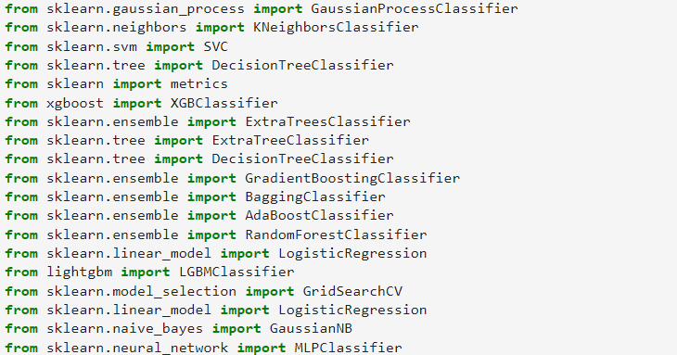
MODELLING
Importing the necessary Classifiers and Models:
3/21/2024 Annual Review

Slide 10
RESULTS Model Performance: Accuracy: 0.84 Precision: 0.88 Recall: 0.82 F1-score: 0.84 These results demonstrate the effectiveness of the Random Forest classifier in predicting Alzheimer's disease and provide valuable insights for healthcare professionals, researchers, and stakeholders involved in Alzheimer's diagnosis and treatment.
3/21/2024 Annual Review

Slide 11
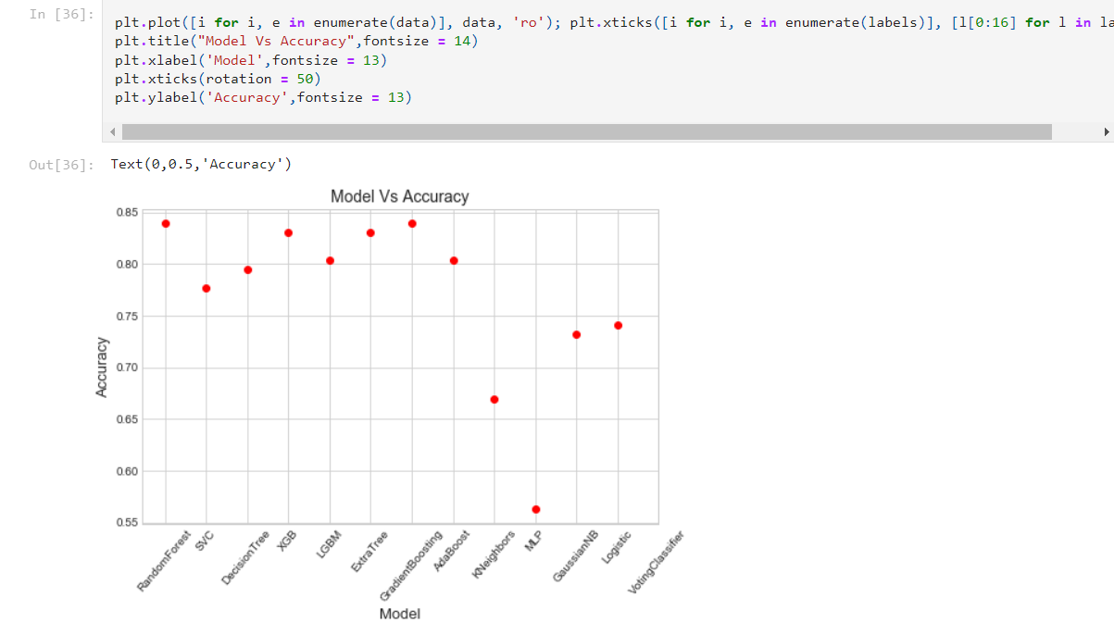
Accuracy of the model

